Slide 1
Calculo Numérico I Raíces de ecuaciones –Métodos Abiertos - II
Dr. Luis Sanchez

Slide 2
Objectives
Knowing how to implement both the secant and the modified secant methods.
Know the Brent’s Root-location Method.
Knowing how to implement both Modified Newton’s Method for Roots with Multiplicity 2 or Higher.
Knowing how to use MATLAB’s fzero function to estimate roots.
Learning how to manipulate and determine the roots of polynomials with MATLAB.

Slide 3
Secant Methods
A potential problem in implementing the Newton-Raphson method is the evaluation of the derivative - there are certain functions whose derivatives may be difficult or inconvenient to evaluate.
For these cases, the derivative can be approximated by a backward finite divided difference:

Slide 4
Secant Methods
Substitution of this approximation for the derivative to the Newton-Raphson method equation gives:
Note - this method requires two initial estimates of x but does not require an analytical expression of the derivative.

Slide 5
Secant Method

Slide 6
Secant Method - Flowchart
NO
Yes
Stop

Slide 7
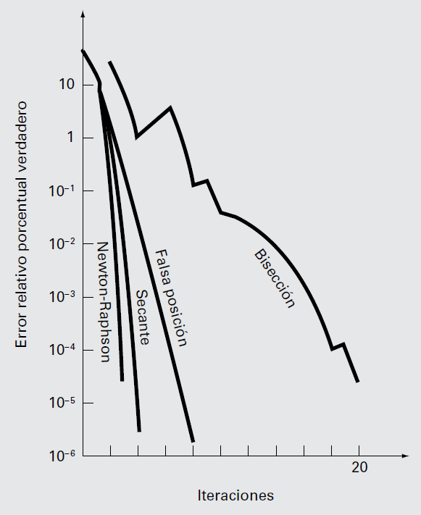
Comparación de los errores relativos porcentuales verdaderos e_{t}, para los métodos que determinan las raíces de f (x) = e^{–x} – x.

Slide 8
Modified Secant Method

Slide 9
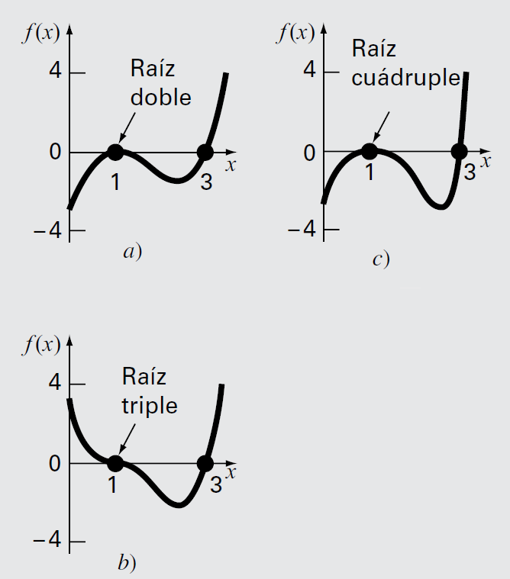
Modified Newton’s Method for Roots with Multiplicity 2 or Higher
Ejemplos de raíces múltiples que son tangenciales al eje x. Observe que la función no cruza el eje en los casos de raíces múltiples pares a) y c), mientras que con multiplicidad impar si lo hace en b).

Slide 10

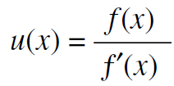
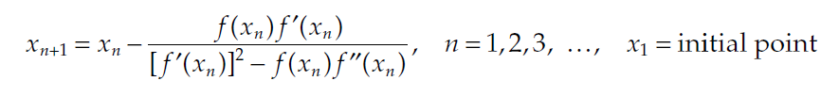
Newton’s method may be modified to improve the speed an the convergence. The modified Newton’s method designed for roots of multiplicity 2 or higher proposed by Ralston and Rabinowitz (1978).
Consiste en definir una nueva función u(x), que es el cociente de la función original entre su derivada, Se puede demostrar que esta función tiene raíces en las mismas posiciones que la función original.

Slide 11
function [r, n] = NewtonMod(f,fp,f2p, x1, tol, N)
%UNTITLED3 Summary of this function goes here
% Detailed explanation goes here
if nargin < 4 || isempty(N)
N = 20;
end
if nargin < 3 || isempty(tol)
tol = 1e-4;
end
x = zeros(1,N+1); % Pre-allocate
x(1) = x1;
for n = 1:N,
x(n+1) = x(n) - (f(x(n))*fp(x(n)))/(fp(x(n))^2-f(x(n))*f2p(x(n)));
if abs(x(n+1)-x(n)) < tol,
r = x(n+1);
return
end
end
end

Slide 12
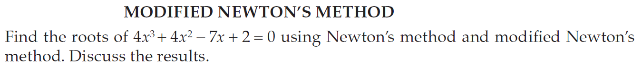
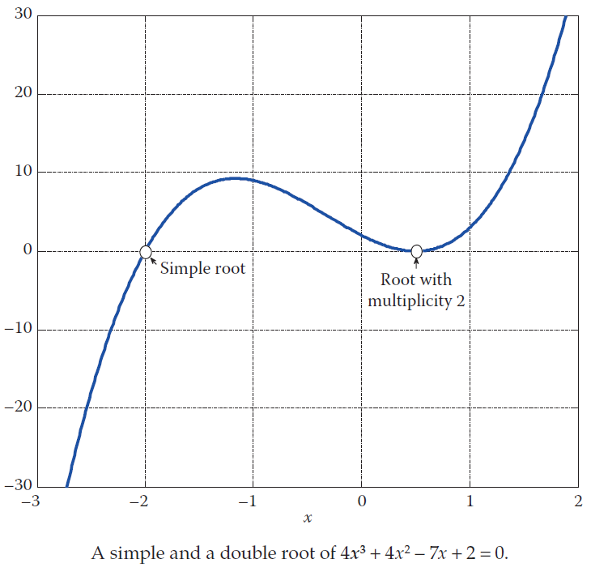
Example :

Slide 13
Brent’s Root-location Method
A hybrid approach that combines the reliability of bracketing with the speed of open methods
Try to apply a speedy open method whenever possible, but revert to a reliable bracketing method if necessary
That is, in the event that the open method generate an unacceptable result (i.e., an estimate falling outside the bracket), the algorithm reverts to the more conservative bisection method
Developed by Richard Brent (1973)
Here the bracketing technique being used is the bisection method, whereas two open methods, namely, the secant method and inverse quadratic interpolation, are employed
Bisection typically dominates at first but as root is approached, the technique shifts to the fast open methods

Slide 14
Inverse Quadratic Interpolation
Inverse quadratic interpolation is similar in spirit to the secant method
The secant method: compute a straight line that goes through two guesses and take the intersection of the straight line with the x axis as the new root estimate
Inverse quadratic interpolation: compute parabola (quadratic curve), a function of x, that goes through three points and take the intersection of the parabola with the x axis as the new root estimate
However, it is possible that the parabola might not intersect the x axis
Inverse quadratic interpolation rectifies the difficulty by fitting the points with a parabola in y (a function of y)

Slide 15
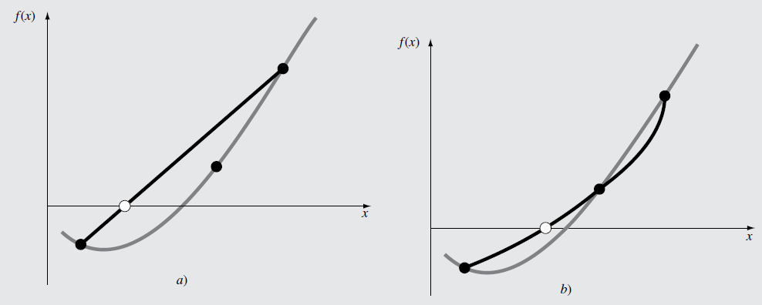
Inverse Quadratic Interpolation
Comparación de a) el método de la secante y b) interpolación inversa cuadrática. Observe que la parábola negra que pasa por los tres puntos en b) se llama “inversa” porque se escribe en y en vez de en x.

Slide 16
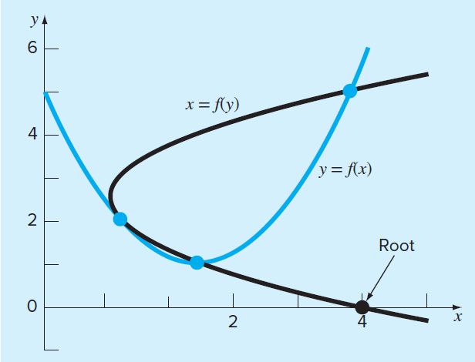
Inverse Quadratic Interpolation
The inverse quadratic
interpolation x=f(y)
always intersect the x axis.

Slide 17
Inverse Quadratic Interpolation (IQI)
The new root estimate, x_{i+1}, therefore, corresponds to y=0
-Substituted into the equation shown above, we can have

Slide 18
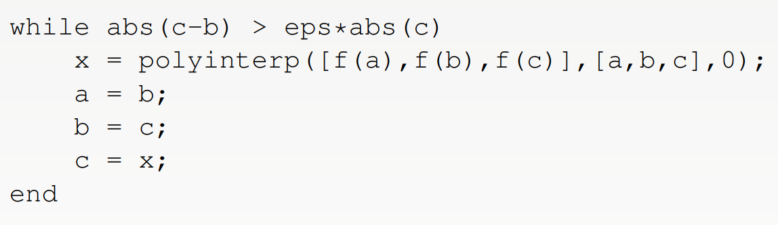
Algorithm IQI
See the MATLAB Live script IQIDemo.mlx which calls the function IQI.m. Remark One of the major challenges for the IQI method is to ensure that the function values, i.e., f(a), f(b) and f(c), are distinct — since we are using them as our interpolation nodes.

Slide 19
MATLAB’s fzero Function
MATLAB’s fzero provides the best qualities of both bracketing methods and open methods.
Using an initial guess:
x = fzero(function, x0) [x, fx] = fzero(function, x0)
function is a function handle to the function being evaluated
x0 is the initial guess
x is the location of the root
fx is the function evaluated at that root
Using an initial bracket:
x = fzero(function, [x0 x1]) [x, fx] = fzero(function, [x0 x1])
As above, except x0 and x1 are guesses that must bracket a sign change

Slide 20
fzero Options
Options may be passed to fzero as a third input argument - the options are a data structure created by the optimset command
options = optimset(‘par₁’, val₁, ‘par₂’, val₂,…)
par_{n} is the name of the parameter to be set
val_{n} is the value to which to set that parameter
The parameters commonly used with fzero are:
display: when set to ‘iter’ displays a detailed record of all the iterations
tolx: A positive scalar that sets a termination tolerance on x.

Slide 21
fzero Example
options = optimset(‘display’, ‘iter’);
Sets options to display each iteration of root finding process
[x, fx] = fzero(@(x) x^10-1, 0.5, options)
Uses fzero to find roots of f(x)=x¹⁰-1 starting with an initial guess of x=0.5.
MATLAB reports x=1, fx=0 after 35 function counts

Slide 22
Polynomials
MATLAB has a built in program called roots to determine all the roots of a polynomial - including imaginary and complex ones.
x = roots(c)
x is a column vector containing the roots
c is a row vector containing the polynomial coefficients
Example:
Find the roots of
f(x)=x⁵-3.5x⁴+2.75x³+2.125x²-3.875x+1.25
x = roots([1 -3.5 2.75 2.125 -3.875 1.25])

Slide 23
Polynomials (cont)
MATLAB’s poly function can be used to determine polynomial coefficients if roots are given:
b = poly([0.5 -1])
Finds f(x) where f(x) =0 for x=0.5 and x=-1
MATLAB reports b = [1.000 0.5000 -0.5000]
This corresponds to f(x)=x²+0.5x-0.5
MATLAB’s polyval function can evaluate a polynomial at one or more points:
a = [1 -3.5 2.75 2.125 -3.875 1.25];
If used as coefficients of a polynomial, this corresponds to f(x)=x⁵-3.5x⁴+2.75x³+2.125x²-3.875x+1.25
polyval(a, 1)
This calculates f(1), which MATLAB reports as -0.2500

